Slide 1


Slide 2
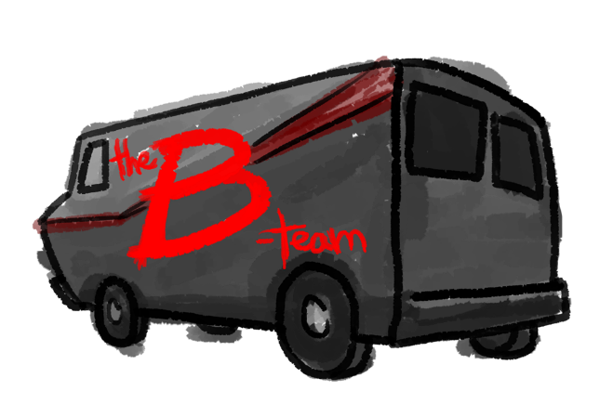

Slide 3
🐾
Play
Options
Quit

Slide 4
🐾
Options

Slide 5
Options
Ok
Cancel

Slide 6
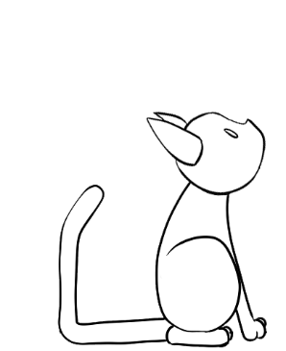
The Most Popular Cat on the Internet
🐾
Options

Slide 7
🐾
Quit

Slide 8
Quit
Are you sure you want to quit?
Yes
No

Slide 9
🐾
Quit

Slide 10
🐾
Options

Slide 11
🐾
Play
Options
Quit

Slide 12
Levels
1
2
3
4
5
6
Ok
Cancel

Slide 15
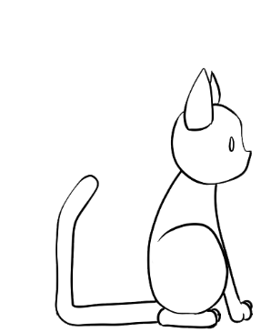

Slide 16
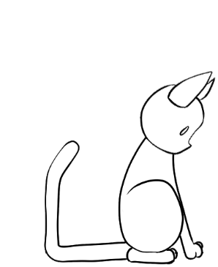

Slide 17
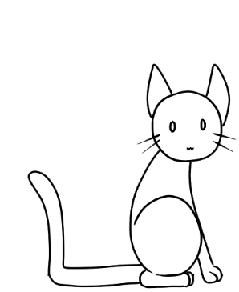

Slide 19


Slide 22

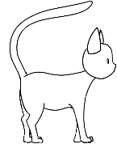
🐱 1 0 🕓 5:00

Slide 23
🐱 1 0 🕓 4:57
mew

Slide 24
🐱 1 0 🕓 4:55
!

Slide 25
Challenge accepted!

Slide 26
🐱 1 0 🕓 4:50
Mittens thinks you’re okay.
to escape.

Slide 27
🐱 1 0 🕓 4:45

Slide 28
🐱 1 0 🕓 4:40

Slide 29
🐱 1 0 🕓 4:35

Slide 30
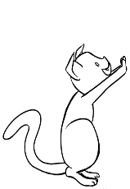
🐱 1 10 🕓 4:30

Slide 31
🐱 1 10 🕓 4:25

Slide 32
🐱 1 10 🕓 4:20

Slide 33
🐱 1 10 🕓 4:15

Slide 34
🐱 1 10 🕓 4:15

Slide 35

🐱 1 10 🕓 4:15
Mittens suggests you check yourself before you wreck yourself.
to escape.

Slide 36
🐱 1 10 🕓 4:15

Slide 37
🐱 1 10 🕓 4:15

Slide 38
🐱 1 10 🕓 4:15

Slide 39
🐱 1 20 🕓 4:15

Slide 40
🐱 1 20 🕓 4:15

Slide 41
🐱 1 20 🕓 4:15

Slide 42
🐱 1 30 🕓 4:15

Slide 43
🐱 1 30 🕓 4:15
Mittens is super impressed by your skills!

Slide 44
Number of moves | 80
Longest streak | 20
Accuracy | 95%

Slide 45
Mittens has joined your posse.

Slide 46
🐱 2 30 🕓 4:15

Slide 47
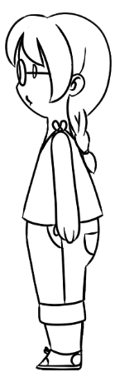
🐱 2 30 🕓 4:15

Slide 48
🐱 2 30 🕓 4:15
mew

Slide 49
🐱 2 30 🕓 4:15
!

Slide 50
Showtime!

Slide 51
🐱 2 30 🕓 4:15
The human thinks you’re okay.
to escape.

Slide 52
🐱 2 30 🕓 4:15

Slide 53
🐱 2 30 🕓 4:15

Slide 54
🐱 2 30 🕓 4:15

Slide 55
🐱 2 40 🕓 4:15

Slide 56
🐱 2 30 🕓 4:15

Slide 57
🐱 2 30 🕓 4:15

Slide 58
🐱 2 30 🕓 4:15

Slide 59
🐱 2 30 🕓 4:15

Slide 60
🐱 2 30 🕓 4:15

Slide 61
🐱 2 30 🕓 4:15
The human is super impressed by your skills.
Get ready for your close up!

Slide 62
🐱 2 30 🕓 4:15

Slide 63
🐱 2 30 🕓 4:15

Slide 64
🐱 2 30 🕓 4:15

Slide 65
🐱 2 30 🕓 4:15

Slide 66
🐱 2 30 🕓 4:15

Slide 67
🐱 2 30 🕓 4:15

Slide 68
Number of moves | 80
Longest streak | 20
Accuracy | 85%
Fame | 2/3

Slide 70
